Slide 1
Analysis of Pollutants and Health Impacts in NYC
NO2
PM2.5
NO
Team Members: Rijul Chaturvedi Ninad Bhikaje Tanu Rana Rushikesh Shinde
C

Slide 2
Table of Contents
1
Introduction
Data Source & Methodology
2
3
Data Cleaning & Preparation
4
Pollutants Infographics
5
Results
Discussions
6
7
Conclusions

Slide 3
Introduction
1
2
Problem Statement
Air pollution poses a severe environmental and public health challenge, especially in urban areas like New York City.
Vulnerable communities face disproportionate exposure due to factors like traffic congestion, industrial activities, and socioeconomic disparities.
Motive
Analyze trends in PM2.5, NO2, SO2, and BC concentrations over time (2009–2022).
Link PM2.5 exposure to health outcomes to highlight its impact on respiratory and cardiovascular conditions.

Slide 4
Data Source & Methodology
1
2
Data Source
Air Quality Data Explorer:
Contains pollutant concentration levels for PM2.5, NO2, SO2, and BC across NYC neighborhoods.
Covers temporal trends and geographic variations from 2009 to 2022.
Health Impacts of Air Pollution:
Provides detailed information on the health consequences of air pollution exposure in NYC.
Includes data on respiratory and cardiovascular conditions linked to PM2.5.
Methodology
Analyze trends in PM2.5, NO2, SO2, and BC concentrations over time (2009–2022).
Link PM2.5 exposure to health outcomes to highlight its impact on respiratory and cardiovascular conditions.

Slide 5
Pollutants Infographics
Pollutant | Sources | Health Effects
PM2.5 | Fuel combustion in vehicles, boilers in buildings, power plants, construction equipment, marine vessels and commercial cooking. | It is small enough to penetrate deep into the lungs and enter the bloodstream, which can worsen lung and heart disease and lead to hospital admissions and premature deaths.
NO2 | It reacts with other compounds in the atmosphere to form PM_{2.5} and O_{3.} Combustion sources like motor vehicles, buildings, marine vessels and construction equipment. | It is linked to increased emergency department visits and hospitalizations for respiratory conditions, particularly asthma
SO2 | Burning oils with high sulfur content, such as No. 4 and No. 6 oil (also known as residual fuel oil), or high-sulfur No. 2 oil. Primary use of fuel oil in NYC is to heat buildings and water, which is why we only monitor it in the winter. | Exposures can worsen lung diseases, causing hospitalizations and emergency department visits for asthma and other respiratory conditions. SO₂
BC | Emitted from gas and diesel engines, coal-fired power plants, and other sources that burn fossil fuels. It comprises up to 20% of fine particulate matter in New York City. | Inhalation of BC is associated with health problems, including respiratory and cardiovascular disease, cancer and birth defects. BC also contributes to climate change by altering the patterns of rain and clouds.

Slide 6
Citywide, annual average levels of four key pollutants
Fine particles (PM_{2.5})
Nitrogen Dioxide (NO₂)
Nitric Oxide (NO)
Sulfer Dioxide (SO₂)
-43%
-39%
-56%
-98%

Slide 7
Data Cleaning
1
Pollutant Data Extraction
C, NO, NO2 & PM2.5 along with corresponding health data
2
Timeline Sanitization
Harmonization of timelines was done between the health and air quiality data
Data Pre-Processing and Sanitation steps
3
Missing Values
‘NA’ removal for AQ and interpolation for Health Data

Slide 8
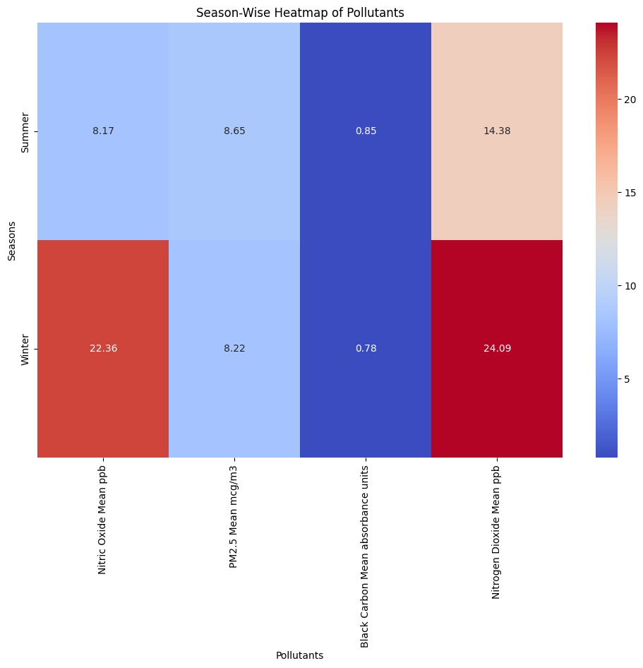
Results: Seasonal Analysis
Nitric Oxide:
• Winter: 22.36 ppb (High)
• Summer: 8.17 ppb (Low)
PM2.5:
• Similar levels in both seasons (~8.2–8.6 µg/m³)
Black Carbon:
• Slightly higher in Summer (0.85) than Winter (0.78)
Nitrogen Dioxide:
• Winter: 24.09 ppb (High)
• Summer: 14.38 ppb (Lower)
Insight: Winter shows higher Nitric Oxide and Nitrogen Dioxide due to increased emissions from heating and traffic.

Slide 9
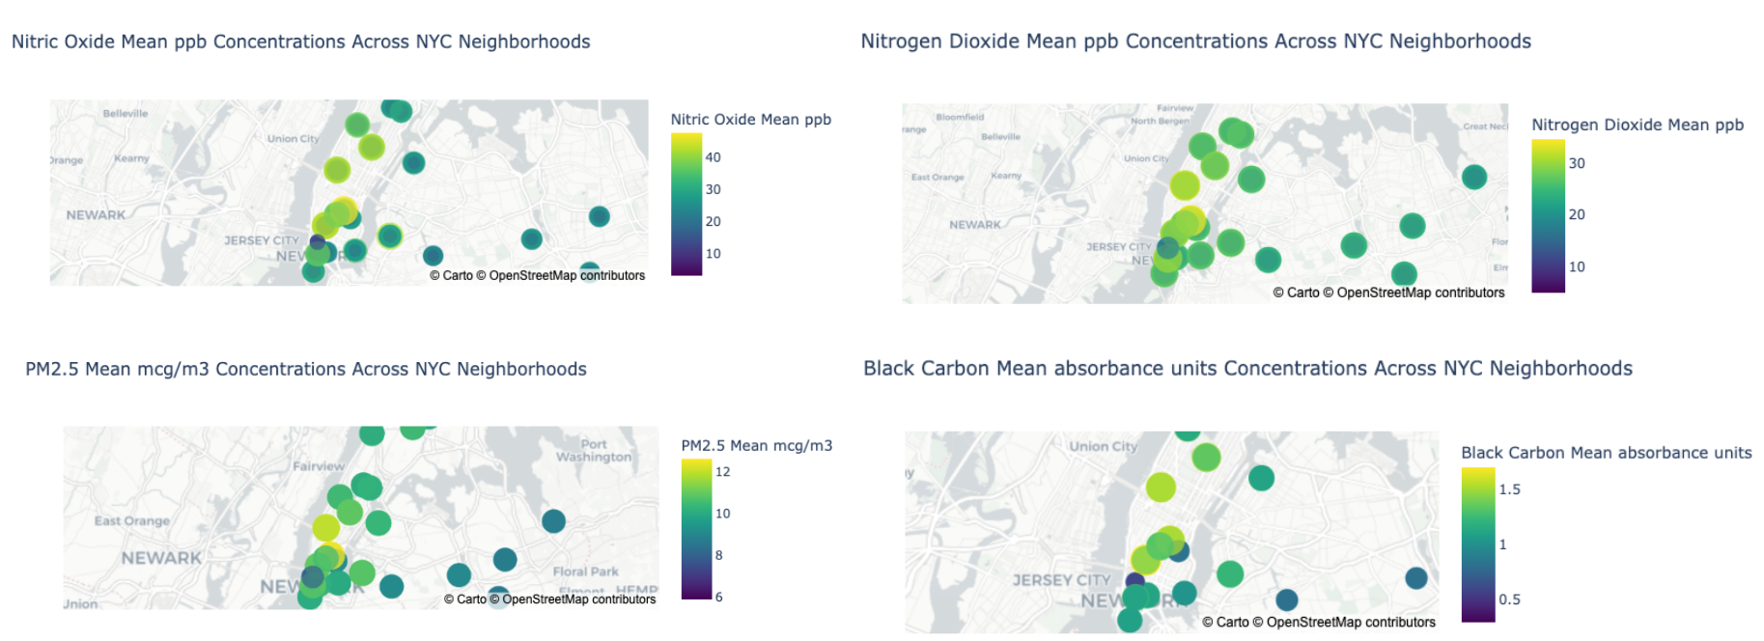
Results: Geographic Analysis (UHF 42)

Slide 10
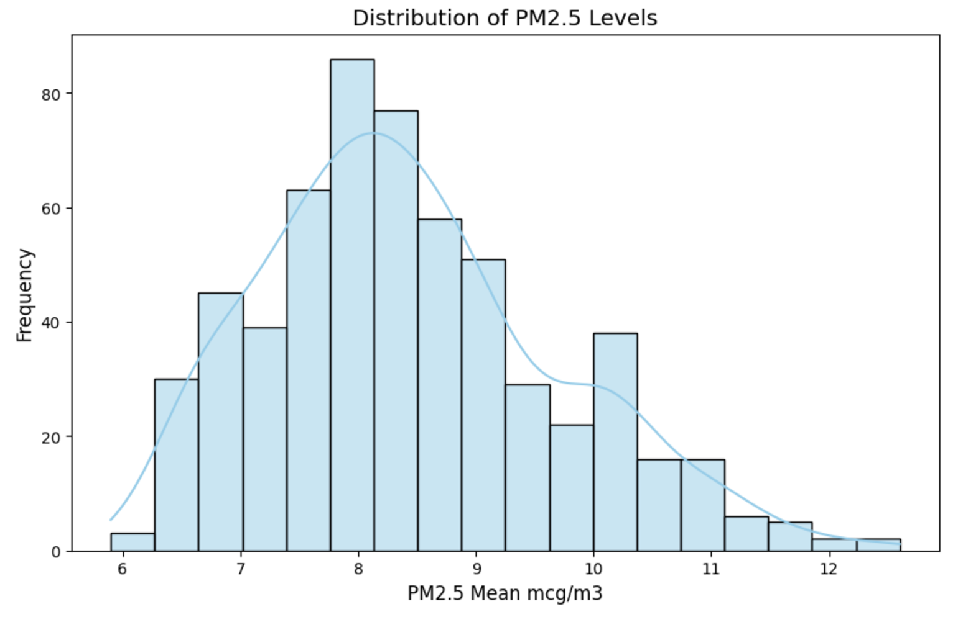
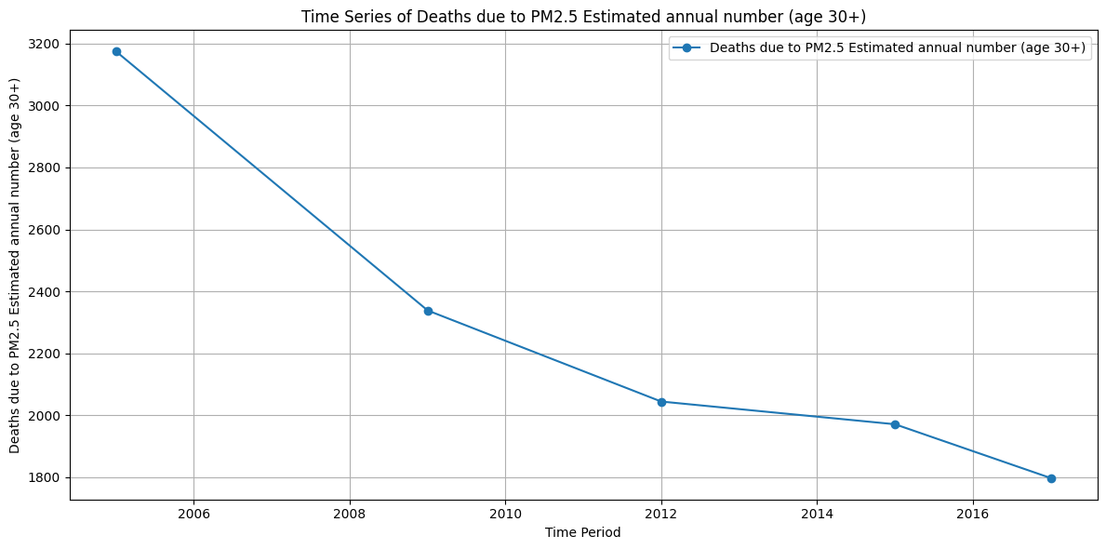
Results: Frequency distribution and Time Series
PM 2.5 Time Series
PM 2.5 Distribution
Annual deaths due to PM2.5 exposure have consistently declined from 2005 to 2016, suggesting improving air quality or health interventions.
PM2.5 levels are concentrated around 7 to 9 µg/m³, with a moderate right skew, indicating occasional higher pollution events.

Slide 11
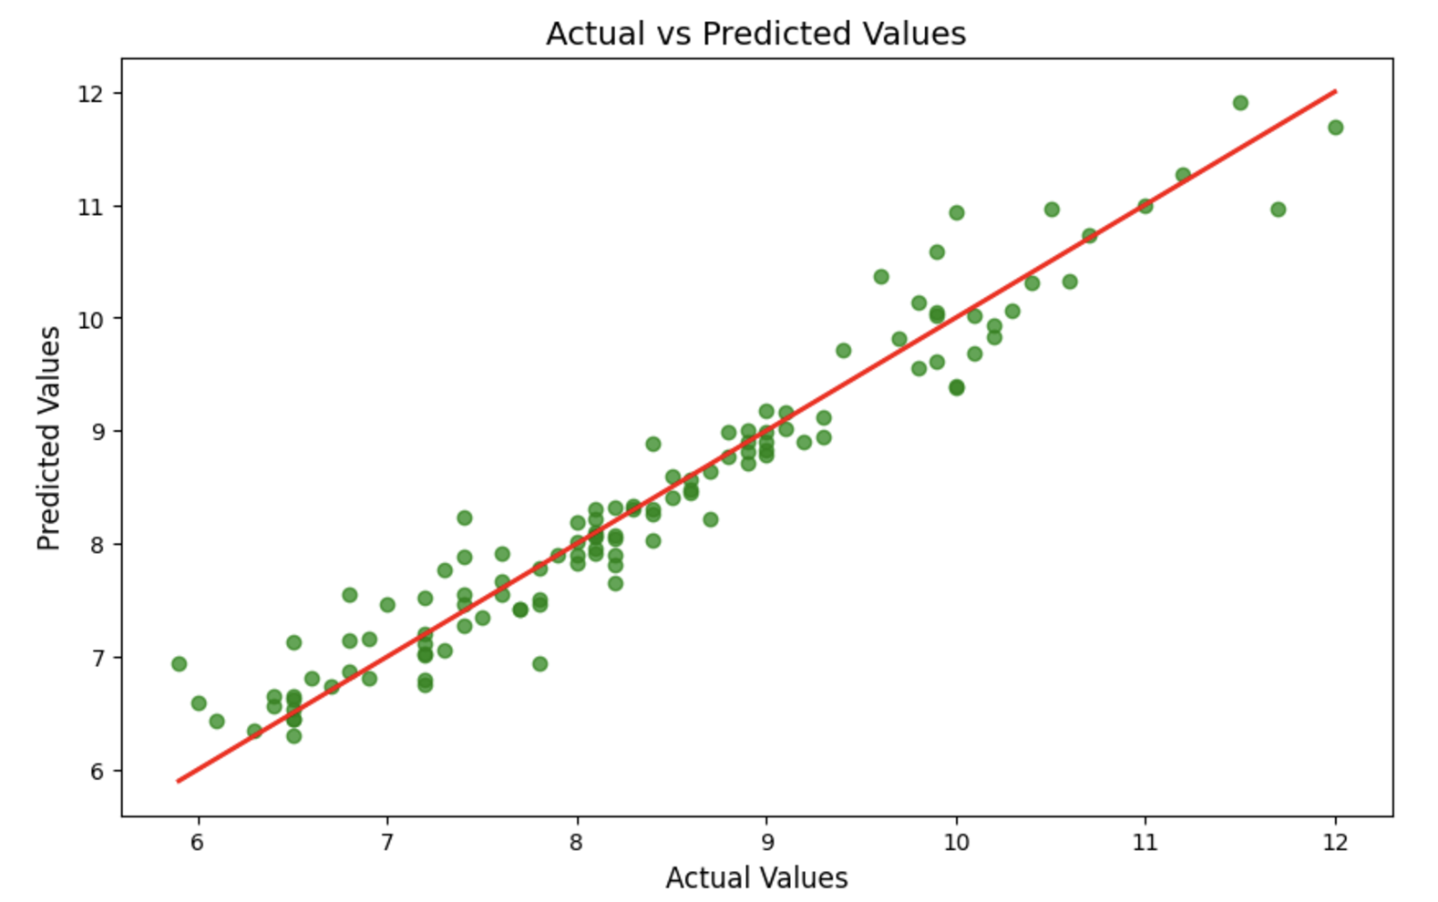
Results: Predictive model for Air Quality

Slide 12
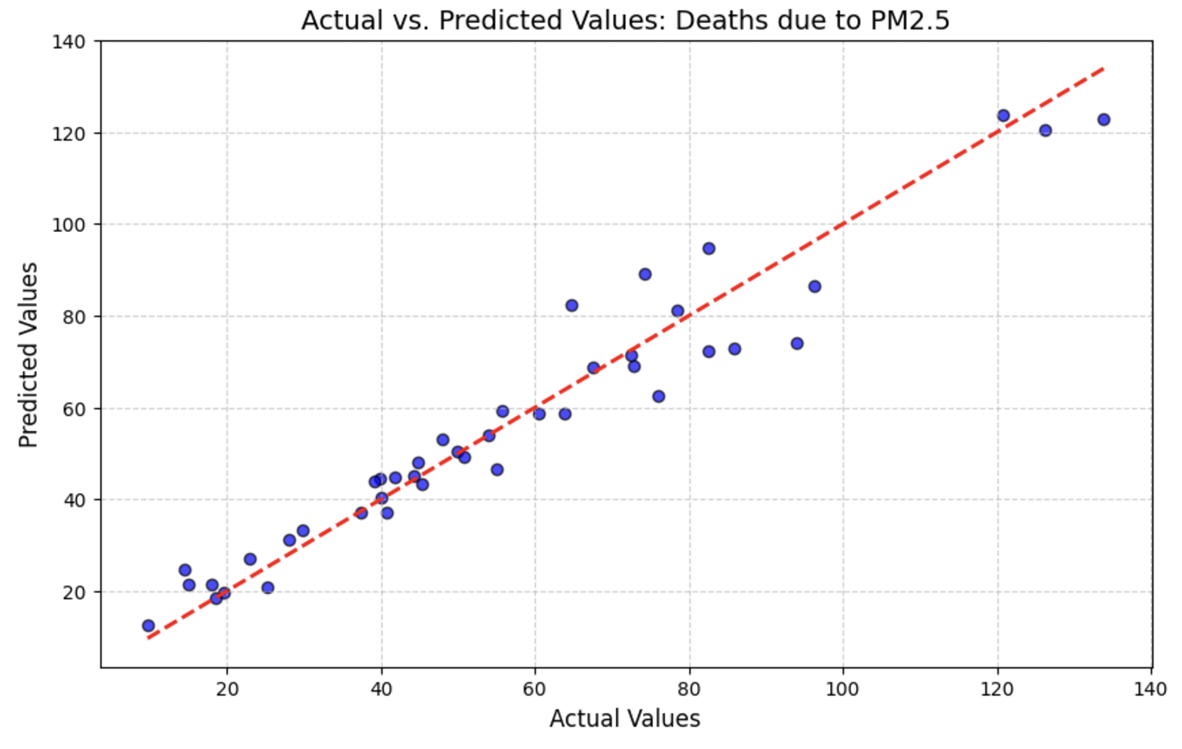
Results: Predictive model for Health

Slide 13
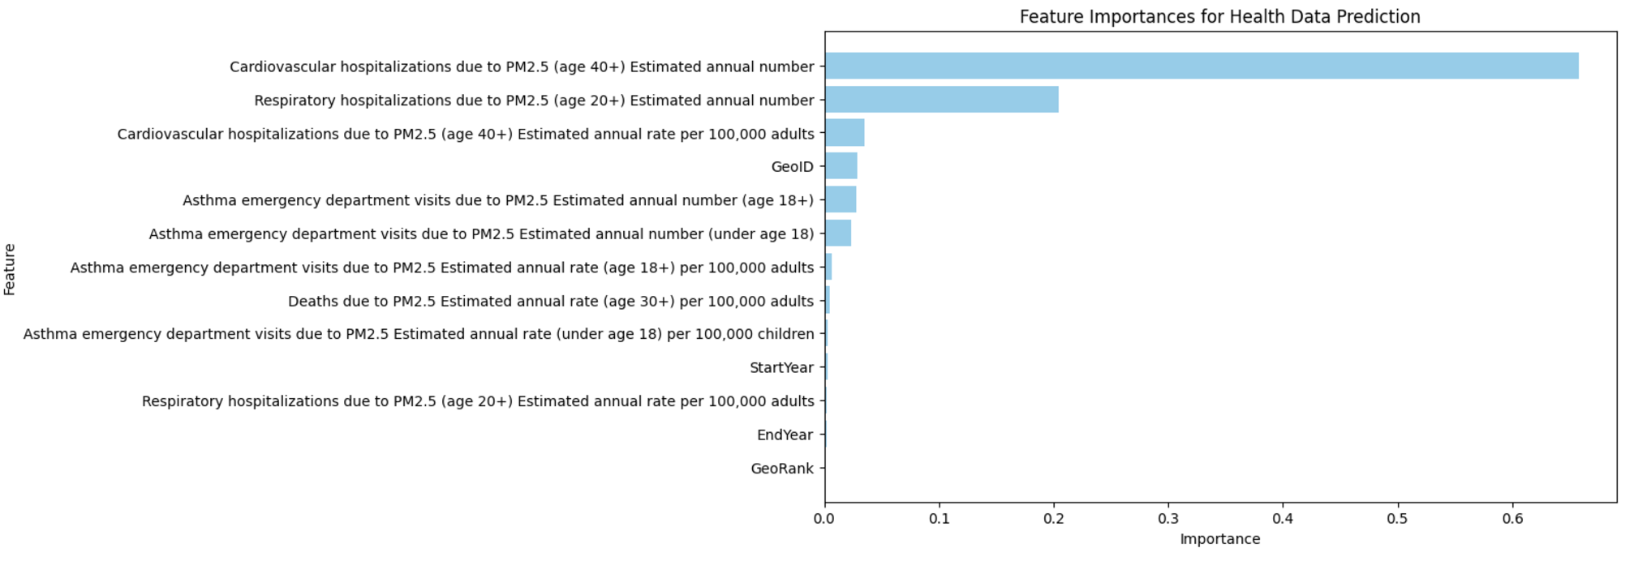
Results: Feature Importances for Health Data Prediction
Key Insight
Cardiovascular and respiratory hospitalizations due to PM2.5 dominate predictive power, while temporal features and GeoRank have negligible impact.

Slide 14
Discussions
Data-Driven Public Health Strategies:
By integrating pollutant trends with health data, this study demonstrates the potential for data-driven approaches in addressing environmental health challenges. Future work could include real-time monitoring systems to identify high-pollution events and proactively mitigate their impacts (Van Donkelaar et al., 2010).
Progress in Air Quality Improvement:
While overall pollutant levels have declined in NYC over the past decade, seasonal peaks during winter and hotspots in densely populated areas persist. This calls for year-round monitoring and seasonal emission control policies (Dominici et al., 2006).
Impact of PM2.5 on Vulnerable Populations:
Long-term PM2.5 exposure is linked to increased hospitalization rates for asthma and other respiratory diseases, particularly among children and the elderly in underserved neighborhoods. These findings align with studies linking PM2.5 to disproportionate health burdens in urban communities (Brunekreef & Holgate, 2002).

Slide 15
Limitation & Future Direction
Limitations:
Data Availability:
Health data was only available for PM2.5, limiting a comprehensive evaluation of other pollutants' health impacts.
Gaps in real-time air quality data reduce the ability to assess immediate pollutant fluctuations.
Geographic Scope:
While the analysis focused on NYC, data granularity for some neighborhoods was insufficient, which could lead to underrepresentation of certain areas.
Variable Integration:
Socio-economic, industrial, and traffic pattern data were not incorporated, potentially leaving out important contributing factors.
Future Direction:
Industrial, and traffic pattern data were not incorporated, potentially leaving out important contributing factors.

Slide 16
Conclusion
This study highlights significant temporal and spatial disparities in air pollutant concentrations (PM2.5, NO2, SO2, BC) across New York City from 2009 to 2022.
The correlation between PM2.5 exposure and adverse health outcomes reinforces the need for targeted interventions to reduce pollutant levels and protect public health.
Vulnerable communities, particularly in areas like upper east of NYC, experience disproportionate exposure to harmful pollutants.

Slide 17
References
The New York City Community Air Survey
Air Quality(Pollutants Data - NYC)
Pollutant Health Data(NYC)
Van Donkelaar, A., et al. (2010). Global estimates of ambient fine particulate matter concentrations from satellite-based aerosol optical depth: Development and application. Environmental Health Perspectives, 118(6), 847-855.
Dominici, F., et al. (2006). Fine particulate air pollution and hospital admission for cardiovascular and respiratory diseases. JAMA, 295(10), 1127-1134.
Brunekreef, B., & Holgate, S. T. (2002). Air pollution and health. The Lancet, 360(9341), 1233-1242

Slide 18
THANK YOU!

